Slide 1
Senior Class Meeting Presentation
Wednesday, August 10th

Slide 2
Agenda Meeting Items
Senior Dues
Cap & Gown
Q & A
Welcome - Dr. Price, Miss Reid, Dr. Wright, Mrs. Belser, Ms. Sanders, Mr. Shrewsbury
Senior Pictures - Cady Studios
College & Career Advisor

Slide 3
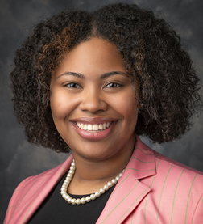
Contact Representatives
Miss Reid SHS Senior Advisor treid@rockdale.k12.ga.us
Mrs. Belser SHS Media Specialist/Yearbook nbelser@rockdale.k12.ga.us

Slide 4
Contact Representatives
Ms. Sanders SHS College & Career Advisor tsanders@rockdale.k12.ga.us
Dr. Wright Graduation Specialist jlesterwright23@rockdale.k12.ga.us

Slide 5
Contact Representatives
Ms. Mitchell Counselor Serving last names P-Z mmitchell4@rockdale.k12.ga.us
Mrs. Latimore Head Counselor Serving last names H-O klatimore@rockdale.k12.ga.us

Slide 6
Contact Representatives
Ms. Robbins Counselor Serving last names A-G srobbins23@rockdale.k12.ga.us

Slide 7
Graduation Requirements

Slide 8
Graduation Requirements
English/Language Arts | Social Studies | Mathematics | Mathematics Cont.
4 units, must include: 1 unit 9th grade Literature/Composition 1 unit American Literature/Composition | 4 units, must include: 1 unit Government 1 unit World History 1 unit U.S. History 1 unit Economics | 4 units, must include: 1 unit Coordinate Algebra or Accelerated Coordinate Algebra/Analytic Geometry A 1 unit Analytic Geometry or Accelerated Analytic Geometry B/Advanced Algebra 1 unit Advanced Algebra (if not passed in Accelerated Analytic Geometry B/Advanced Algebra), the following are located in “Mathematics Cont.” | Foundations of Algebra (Select students only-Grade 9) Advanced Mathematical Decision Making Statistical Reasoning College Readiness Math Pre-Calculus or Accelerated Pre-Calculus Calculus AP Calculus AB/BC AP Statistics Dual-enrollment courses that match or exceed these course levels

Slide 9
Graduation Requirements Continued . . .
Science | Health/Safety | Physical Education (PE) | Fine Arts/ Computer Tech. / ROTC
4 units, must include: 1 unit Biology or Honors Biology 1 unit Physical Science, Physics, Chemistry, or Honors Chemistry 1 unit Chemistry, Honors Chemistry, Earth System, Environmental Science, Physics or an AP Science 1 additional unit science unit | ½ unit (or 2 units ROTC) | ½ unit Personal Fitness | 0 units required IMPORTANT – Students planning to enter post-secondary technical college, college, military, or the workforce should carefully consider how courses in these areas may affect their post-secondary options.

Slide 10
Graduation Requirements Continued . . .
World Languages | CTAE (Career, Technical, Agricultural Education) | Electives | Electives Continued...
 | 3 Units Required IMPORTANT – 3 in the same career pathway is required for certification and pathway completion. Failure to complete three units in the same pathway may adversely affect post-secondary choices for students planning to enter technical college or the workforce. | 7 units, should include: 3 units CTAE (same pathway) 2 units foreign language 2 additional electives OR | 3 units CTAE (same pathway) 4 additional units of CTAE or other electives
0 units required IMPORTANT – The Board of Regents of the University System of Georgia requires 2 units in the same foreign language (may include American Sign Language) for admission to its two and four-year institutions

Slide 11
Total Credits Required to Graduate: 24
** The 4th Science unit may be used to meet both the science and elective requirement.
1 unit = 2 semesters of credit
Promotion requirements to:
Grade 10 = 5 units
Grade 11 = 11 units*
Grade 12 = 16 units
*Calculated for core courses (English, math, science, social studies, foreign language, fine arts) only. To be classified as an 11th grader (junior), students must earn 11 Carnegie units and pass all required courses in English, math, science, and social studies.
Click Here to Access the Complete Guide

Slide 12
Senior Pictures

Slide 13
Senior Pictures
Most important date for yearbook:
12/02/2022 (Last day to be included in the yearbook)
Cady.com/schedule
Create an account

Slide 14
Senior Pictures
Event | Date | Time | Location
Senior Panoramic (23’) | 9/1/22 | 8:45 - 9:30 | Gym or FB Field (TBD)
Senior Full Road Shoot Formal, Cap & Gown and 2 Casual Scenes | 10/19/22 | 7:30 - 6:00 | Media Center
Senior Yearbook ONLY Formal and Cap & Gown | 11/10/22 | 9:30 - 6 :00 | Media Center

Slide 15
Yearbooks / ads : Online Orders only
Yearbook Price $50 through 8/12/2022
Increases to $55
Yearbook Ads:
Page Size | 10/7/2022 | 11/4/2022 | 11/18/2022
1/2 Page | $100 | $125 | $150
1/4 Page | $60 | $75 | $100

Slide 16
Yearbook Contact
Mrs. Belser
nbelser@rockdale.k12.ga.us
Location: Media Center

Slide 17
College Advisement

Slide 18
Who Am I? What are my services?
I am 2nd year College Adviser Ms. Sanders! I will be assisting ALL senior develop a post-secondary plan. That can range from 4-year university, technical college, trade school, military and more.
College Advising College
Application Help
SAT/ACT Registration
Scholarship Search
Completing Financial Aid
College Related Events
... & many more

Slide 19
IMPORTANT DATES
SAT DATE: OCTOBER 1 REGISTRATION DEADLINE: SEPTEMBER 2
ACT DATE: OCTOBER 22 REGISTRATION DEADLINE: SEPTEMBER 16
FAFSA OPENS
OCTOBER 1ST
FREE APPLICATION FOR FEDERAL STUDENT AID (FAFSA) STUDENTS WILL APPLY FOR FINANCIAL AID FOR MULTIPLE COLLEGES AND FUNDING SOURCES THROUGH FAFSA.GOV

Slide 20
PAYING FOR COLLEGE
TYPES OF AID
SOURCES OF AID
MERIT-BASED SCHOLARSHIPS EX: HOPE NEED-BASED GRANTS EX: PELL GRANT NON-NEED BASED GRANTS STUDENT OR PARENT LOANS WORK-STUDY PROGRAMS
STATE/FEDERAL GOVERNMENT COLLEGE/UNIVERSITIES PRIVATE FOUNDATIONS EMPLOYERS AND PRIVATE COMPANIES
FREE APPLICATION FOR FEDERAL STUDENT AID (FAFSA) STUDENTS WILL APPLY FOR FINANCIAL AID FOR MULTIPLE COLLEGES AND FUNDING SOURCES THROUGH FAFSA.GOV

Slide 21
HOPE/ZELL MILLER SCHOLARSHIP
HOPE REQUIREMENTS
ZELL MILLER REQUIREMENTS
RIGOR COURSES 3.7 HOPE GPA 1200 ON SAT 26 ON ACT
MINIMUM 3.0 GPA FOUR RIGOR COURSE Be active in the class Come on time
*DESIGNATED FOR VALEDICTORIAN OR SALUTATORIAN*
*COVERS A PORTION OF TUTION*
*COVERS FULL STANDARD TUTION*

Slide 22
STAY CONNECTED
EMAIL: TSANDERS@ROCKDALE.K12.GA.US
REMIND
Send a text to 81010 Text this message @@7ffcc3

Slide 23
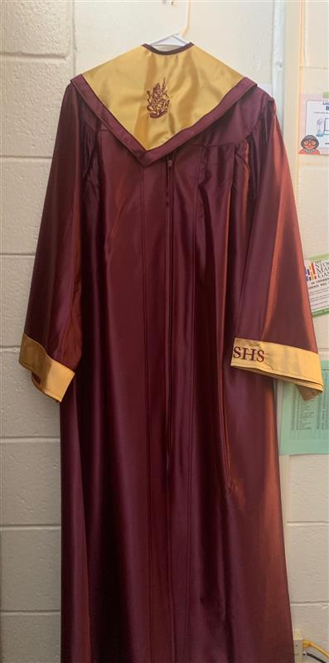
Cap & Gown

Slide 24
Stay Connected with US!
@seminoleseniors_
@shscollegebound
Send a text to 81010 Text this message @nole23

